Slide 1

BOB BUILDER
PRESENTED BY-
21IT156
21IT159

Slide 2

TOPICS
Front end
Path to be covered

Slide 3

Front-End
Login Page
Navigation BAR

Slide 4

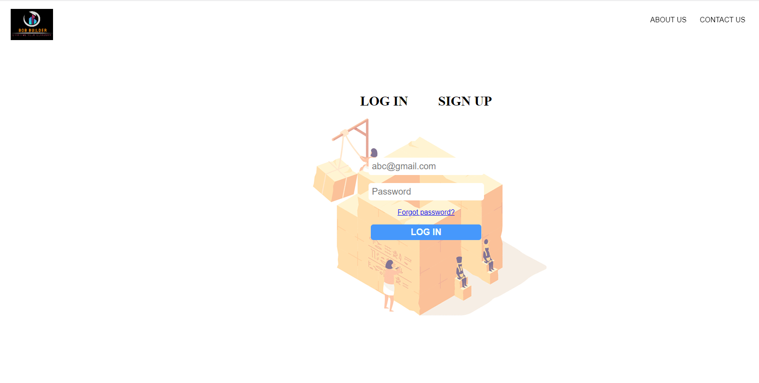
LOGIN PAGE
FIRST TO MARKET
First beautifully designed product that's both stylish and functional

Slide 5
PATH TO BE COVERED
CSS
HTML
JS
Front End
ML
Back End
Python/Node JS
SQL
Flutter

Slide 6

Thank You

